Slide 1

DATABASE COURSE 2023/2024
SESSION 10

Slide 2
SESSION 10
SUBQUERIES
CASE CLAUSE
ROWS OUTPUT LIMITS

Slide 3
SUBQUERIES
Subquery in FROM clause
MySQL/Oracle
SELECT ... FROM table1 AliasTable1 JOINTYPE JOIN (SELECT Field1, Field2 AS AliasField2 FROM Table2 WHERE Field1 = ... ) AliasTable2 ON (AliasTable2.AliasField2 = AliasTable1.Field1) WHERE AliasTable1.Field3 = ... AliasTable2.Field1 = ...

Slide 4
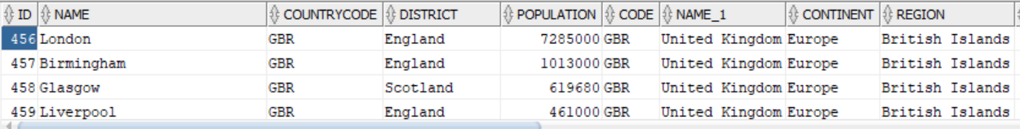
SUBQUERIES
Subquery in FROM clause example
BBDD/User: world
MySQL/Oracle
SELECT *
FROM city INNER JOIN
(SELECT * FROM country WHERE continent = 'Europe') country
ON city.countrycode = country.code;

Slide 5
SUBQUERIES
Subquery in WHERE conditions
MySQL/Oracle
SELECT ...
FROM table1 JOINTYPE JOIN table2
ON (table1.Field1 = table2.Field1)
WHERE (Field1,Field2) IN (SELECT Field1,Field2 FROM ... WHERE ...)
AND (Field1,Field2) NOT IN (SELECT Field1,Field2 FROM ... WHERE ...)
AND EXISTS (SELECT .. FROM ... WHERE ...)
AND NOT EXISTS (SELECT .. FROM ... WHERE ...)

Slide 6
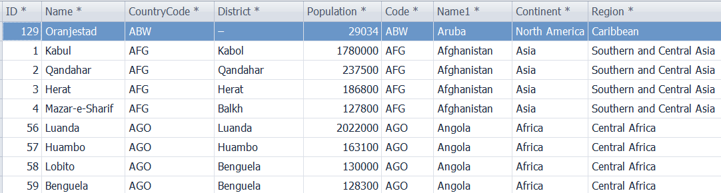
SUBQUERIES
Subquery in WHERE conditions example
BBDD/User: world
MySQL/Oracle
SELECT * FROM city
INNER JOIN country ON city.countrycode = country.code
WHERE country.region NOT IN (SELECT DISTINCT region
FROM country
WHERE UPPER(region) LIKE '%AMERICA')

Slide 7
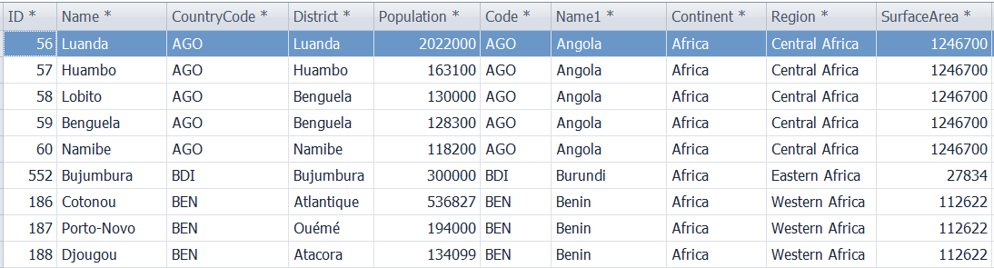
SUBQUERIES
Subquery in WHERE conditions example
BBDD/User: world
MySQL/Oracle
SELECT * FROM city
INNER JOIN country ON city.countrycode = country.code
WHERE country.region IN (SELECT DISTINCT region
FROM country
WHERE UPPER(region) LIKE '%AFRICA')

Slide 8
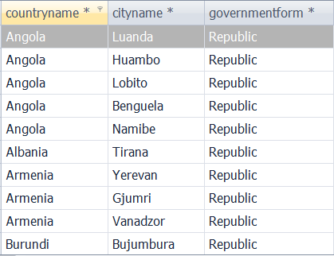
SUBQUERIES
Subquery in WHERE conditions example
BBDD/User: world
MySQL/Oracle
SELECT aliascountry.name AS countryname, city.name AS cityname, aliascountry.governmentform FROM city INNER JOIN country aliascountry ON city.countrycode = aliascountry.code
WHERE EXISTS (SELECT name FROM country
WHERE governmentform = 'Republic'
AND aliascountry.code=code)

Slide 9
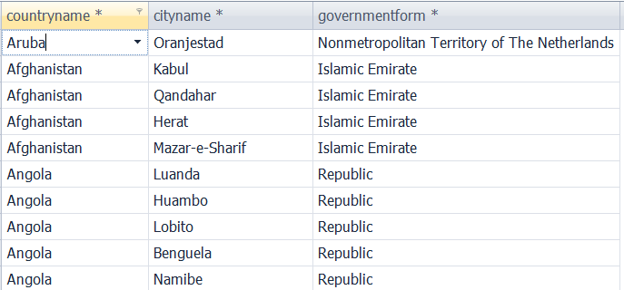
SUBQUERIES
Subquery in WHERE conditions example
BBDD/User: world
MySQL/Oracle
SELECT aliascountry.name AS countryname, city.name AS cityname, aliascountry.governmentform
FROM city INNER JOIN country aliascountry ON city.countrycode = aliascountry.code
WHERE NOT EXISTS (SELECT name FROM country
WHERE UPPER (governmentform) LIKE '%MONARCHY%'
AND aliascountry.code=code)

Slide 10
CASE CLAUSE
CASE Syntax
MySQL/Oracle
SELECT Field1,
CASE
WHEN Field1 >= Value1 THEN NewValueCase1
WHEN Field1 > Value2 AND Field1 < Value1 THEN NewValueCase2
ELSE NewValueCase3
END NewField1
FROM table
MySQL/Oracle
SELECT Field1,
CASE Field1
WHEN Value1 THEN NewValueCase1
WHEN Value2 THEN NewValueCase2
ELSE NewValueCase3
END NewField1
FROM table

Slide 11
SESSION 10
SUBQUERIES
CASE CLAUSE
ROWS OUTPUT LIMITS

Slide 12
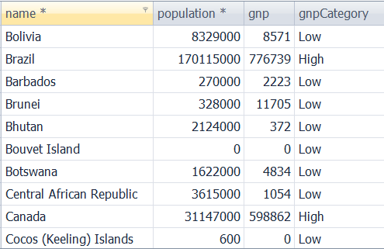
CASE CLAUSE
CASE Example
BBDD/User: world
MySQL/Oracle
SELECT
name, population, gnp ,
CASE
WHEN gnp > 500000 THEN 'High'
WHEN gnp BETWEEN 500000 AND 100000 THEN 'Medium'
ELSE 'Low'
END gnpcategory
FROM country;

Slide 13
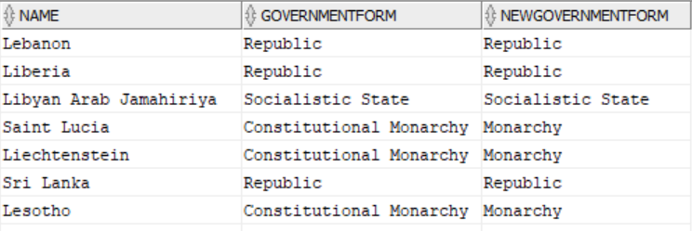
CASE CLAUSE
CASE Example
BBDD/User: world
MySQL/Oracle
SELECT
name, governmentform,
CASE governmentform
WHEN 'Parlementary Monarchy' THEN 'Monarchy'
WHEN 'Constitutional Monarchy' THEN 'Monarchy'
WHEN 'Monarchy' THEN 'Monarchy'
ELSE governmentform
END newgovernmentform
FROM country;

Slide 14
SESSION 10
SUBQUERIES
CASE CLAUSE
ROWS OUTPUT LIMITS

Slide 15
ROWS OUTPUT LIMITS
Limits function Syntax
MySQL
Oracle
SELECT ...
FROM ...
WHERE ...
ORDER BY ...
LIMIT OffSetRows,FetchRows
SELECT ...
FROM ...
WHERE ...
ORDER BY ...
OFFSET OffSetRows ROWS
FETCH NEXT FetchRows ROWS ONLY
MySQL
Oracle
SELECT ...
FROM ...
WHERE ...
ORDER BY ...
LIMIT FetchRows
SELECT ...
FROM (SELECT ...
FROM ...
WHERE ...
ORDER BY...)
AND ROWNUM <= FetchRows
Notes:
In Oracle you can use OFFSET or FETCH NEXT (or both). It is from 12c

Slide 16
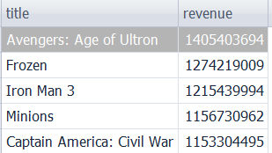
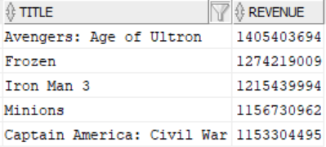
ROWS OUTPUT LIMITS
Limits function Example
BBDD/User: moviebig
MySQL
SELECT title, revenue
FROM moviebig
ORDER BY revenue DESC
LIMIT 5,5;
Oracle
SELECT title, revenue
FROM moviebig
ORDER BY revenue DESC
OFFSET 5 ROWS
FETCH NEXT 5 ROWS ONLY;
Notes:
In Oracle u can use OFFSET or FETCH NEXT (or both). It is from 12c

